Slide 1
How does Kenya’s membership in UPOV impact its crop yields compared to non-UPOV member East African countries?
LaKeta L Kemp, Wendesen King, Stacey Speller, Kholeigh Foster
Howard University
DATA 304: Applied Data Science for Social Impact
Professor Aleshia Berry
19 April 2024
Author ORCID iD:
Kemp: https://orcid.org/0009-0004-5459-1376
King: https://orcid.org/0009-0007-3229-6546
Speller: http://orcid.org/0009-0009-5694-1874
Foster: http://orcid.org/0009-0006-8343-0082

Slide 2
"Analyzing Agricultural Trends: A Focus on Crop Production in East Africa
Hypothesis - UPOV's expansion hasn't boosted crop yields as anticipated
Objective - Evaluate this hypothesis using FAO data from 1961-2021, focusing on crop yield and area harvested. This dataset includes quality flags and UPOV membership info
Approach: Employ SARIMA modeling to forecast crop yields, comparing UPOV member countries in East Africa to non-members. Key crops analyzed are Soybeans, Coffee, and food oils
Key Questions:
-Does UPOV membership correlate with increased crop yields over time?
-How does UPOV affiliation affect crop harvest areas, especially for specific crops?
Notes:
WK

Slide 3
Challenges Beyond UPOV Membership
Access to Resources
Despite UPOV membership, constraints in accessing finance, adequate infrastructure, and reliable markets may impede farmers' ability to adopt improved crop varieties and technologies
Market Dynamics
Fluctuations in global market prices, trade barriers, and competition from other producing countries can influence the profitability of crop production in Kenya, irrespective of varietal improvements facilitated by UPOV membership
Policy Environment
Kenya's UPOV membership alone may not address underlying issues within the agricultural sector, such as land tenure systems, agricultural subsidies, and regulatory frameworks, which are crucial for fostering sustainable agricultural development
Notes:
WK

Slide 4
Literature Review
machine learning models
evaluation metrics
variables
outcome(s)
Giannini, A., Biasutti, M., Held, I.M. et al. A global perspective on African climate. Climatic Change 90, 359–383 (2008). https://doi.org/10.1007/s10584-008-9396-y
Dowd-Uribe, B., Rock, J. S., Spreadbury, T., Chiril, P., & Uminsky, D. Bridging the gap? Public–private partnerships and genetically modified crop development for smallholder farmers in Africa. Plants, People, Planet. https://doi.org/10.1002/ppp3.10453
Thomson, R. (2015). The Yield of Plant Variety Protection. American Journal of Agricultural Economics, 97(3), 762–785. http://www.jstor.org/stable/24477079
Jonge, B. D., Salazar, R., & Visser, B. (2022). How regulatory issues surrounding new breeding technologies can impact smallholder farmer breeding: A case study from the Philippines. Plants, People, Planet, 4(1), 96-105. https://doi.org/10.1002/ppp3.10219
Albuquerque, U.P., Ludwig, D., Feitosa, I.S. et al. Integrating traditional ecological knowledge into academic research at local and global scales. Reg Environ Change 21, 45 (2021). https://doi.org/10.1007/s10113-021-01774-2.
Anbananthen, K. S. M., Subbiah, S., Chelliah, D., Sivakumar, P., Somasundaram, V., Velshankar, K. H., & Khan, M. A. (2021). An intelligent decision support system for crop yield prediction using hybrid machine learning algorithms. F1000Research, 10. https://10.12688/f1000research.73009.1
Notes:
SS

Slide 5
Purpose and Hypothesis
Researchers suspect that the growth of UPOV has not led to increased crop yields over time.
Goal: Test this hypothesis by analyzing publicly available data from the FAO, focusing on hectares of land area harvested and tons of output produced for primary crops from 1961 to 2021 in over 200 countries.
Data supplemented by standardized country codes, units of measurement, quality control flags, and UPOV membership information.
Utilize SARIMA model to predict crop yields.
Compare yields of UPOV member countries in East Africa to non-members, focusing on agricultural products with economic significance like Soybeans, Coffee, and food oils.
Notes:
SS
Great evening everyone, I’m excited to discuss our research study on the impact of UPOV membership on crop yields in East African countries.
Our primary goal is to investigate whether the growth of UPOV has led to increased crop yields over time.
To achieve this, we'll be analyzing publicly available data from the FAO, focusing on hectares of land area harvested and tons of output produced for primary crops from 1961 to 2021 across over 200 countries.
We'll be supplementing this data with information on standardized country codes, quality control flags, and, most importantly, UPOV membership status.
Our analysis will utilize the SARIMA model which Kholeigh and LaKeta will get to momentarily, to predict crop yields and compare the yields of UPOV member countries in East Africa to non-members.
We'll particularly focus on agricultural products like Soybeans, Coffee, and food oils, which have significant economic implications.
By examining these factors, we aim to determine the correlation, if any, between UPOV membership and crop yields.

Slide 6
Research Questions & Exploratory Data Analyses (EDA)
Main Research Questions:
Is UPOV membership positively correlated with higher crop yields? Is the effect noticeable over time?
What impact does joining UPOV have on the area harvested of specific crops? Are certain crops more affected?
Exploratory Data Analysis (EDA):
How are crop types distributed across countries, and how has this changed over time?
Has there been an overall increase or decrease in tons produced and area harvested for each crop type?
How has total area harvested and crop production changed for each country? Cross-reference with current events for context.
Distribution of quality flags across the dataset: Are certain years or areas more robust in data collection?
Notes:
SS
Let's delve deeper into our research questions and the exploratory data analysis we'll be conducting.
Our main research questions revolve around understanding the impact of UPOV membership on crop yields.
Firstly, we wanted to investigate whether UPOV membership is positively correlated with higher crop yields, and if this effect becomes noticeable over time.
Secondly, we explored the specific impact of joining UPOV on the area harvested of different crops, with a focus on identifying any crops that may be more affected than others.
In our exploratory data analysis, we asked several key questions.
We examined how crop types are distributed across countries and how this distribution has changed over time.
We also analyzed trends in tons produced and area harvested for each crop type to identify any overall increases or decreases.
Furthermore, we investigated changes in total area harvested and crop production for each country, looking for correlations with current events.
Lastly, we examined the distribution of quality flags in the dataset to understand data robustness.
Through these analyses, we hoped to gain valuable insights into the relationship between UPOV membership and crop yields, as well as broader trends in agricultural production.

Slide 7
Data Observations
faostat_crops.csv:
79,298 rows of data
Current variable names include: Area Code [int], M49 code [str], Item Code [int], Item Code (CPC) [str], Item [str], Element Code [int], Element [str], and Unit [str]
Annual data for the year is formatted as Y#### [float], flags for the year are Y####F [str], and notes for the year are Y####N
Listed for years 1961 to 2021
faostat_flags.csv:
13 rows of data with two variables: Flag and Flags
faostat_country_codes.csv:
345 rows of data with 7 variables: Country Code, Country, M49 Code, ISO2 Code, ISO3 Code, Start Year, and End Year
Listed years: 1992-2011
faostat_untis.csv:
60 rows of data with two variables: Unit Name and Description
Requires encoding
upov_member.csv:
76 rows of data with two variables: Country and Entry Year
Notes:
LK

Slide 8
Data Cleaning
faostat_crops.csv:
Variables Y####, Y####F, Y###N extracted as individual lists from dataset and transformed from column to row data
Used numpy methods for matrix transformations
A set of columns created for Year, Flag, and Notes
Data in Y-labeled columns added to the row view
written as a for loop to extract year from header and complete the dataframe
ReadMe file indicated null values needed to be dropped
not all flag or note fields are completed
.dropna() used for missing values in Year column
faostat_flags mapped to the faostat_crops dataset
faostat_country_codes.csv joined with upov_members.csv on Country
faostat_units.csv:
Should be utilized as labels on future generated plots
Represents categorical data that will require encoding
Considering using it to ensure scaling is appropriate and values are ordered correctly based on units
Transposed data to be longitudinal to prepare for model
Notes:
KF
S&P 500 Grains Commodity Index Mapping

Slide 9
Model Selection, Evaluation, and Performance
Based on the literature review, a SARIMA model was selected:
Seasonal Autoregressive Integrated Moving Average
Time series forecasting model that incorporates autoregression, differencing, and moving average with regards to seasonality
Aims to capture patterns and dependencies such as trends and random fluctuations
Evaluation Metrics:
Root Mean Square Error (RMSE): varies depending on country
Mean Absolute Error (MAE): 15530.4
Akaike Information Criterion(AIC): 0.7
Bayesian Information Criterion (BIC):0.3
Performance:
A larger dataset with more observations is needed to assist with estimating parameters accurately
Notes:
KF
Explain how each of the evaluation metrics aid in eval model’s accuracy and goodness of fit.

Slide 10
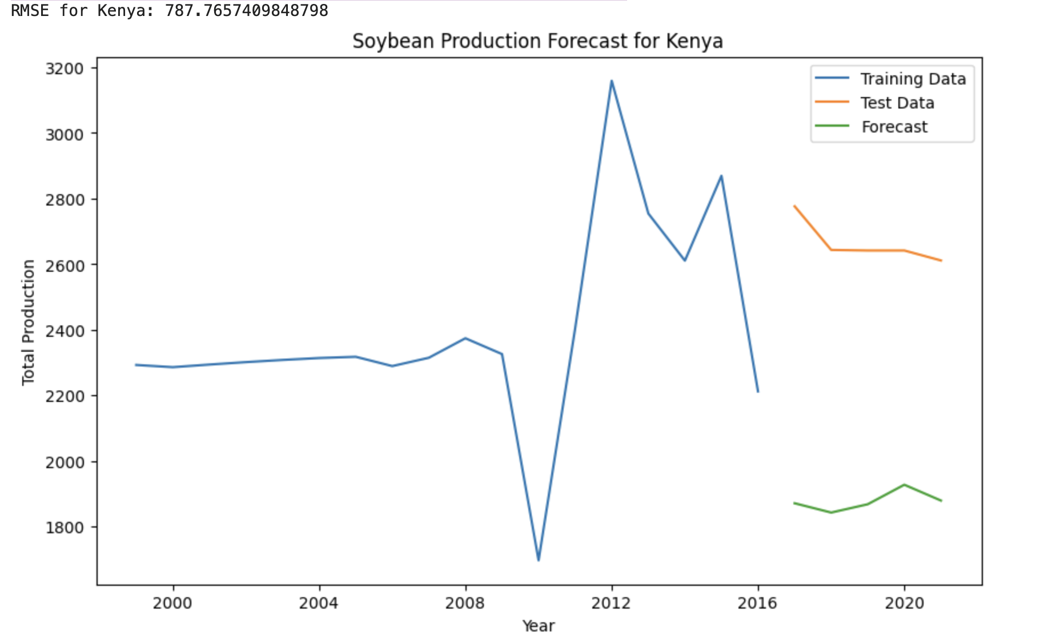
Soybean Production Forecast: Kenya
Evaluations:
Parameter tuning allowed for the gap between test data and forecast to close slightly
Notes:
KF

Slide 11
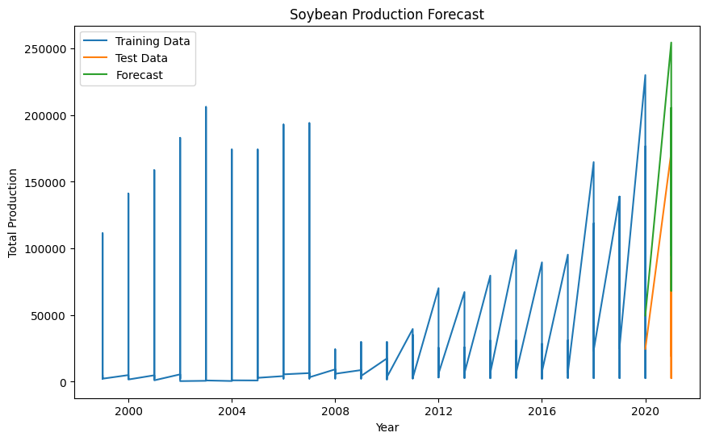
Social Impact
The geopolitical conflict in the East African Region complicated the data cleaning and model results.
Consistency in the data is necessary for reliable predictions of the results.
Predictions of agricultural crops within the Financial Market Commodity Index may give insight into economic stability of the nation.
Notes:
LK
The political conflicts of the East African region were noted in the data. for example, the civil war between Eritrea and Ethiopia produced a division from a single source into two independent sources of data, often missing data for years from ongoing conflict. This gave the appearance of stationarity into the data and required special treatment.
Likewise the ongoing civil war in Sudan caused a division in the data to Sudan and Southern Sudan where reporting for each country gave the appearance of stationarity and disrupted the periodicity of the data.
The residual impact of British colonial rule on the government structure and community connection left disjointed results for UPOV member Kenya.
While some of the missing values could be sourced from World Bank, this widely accepted data source is also missing data from conflict years. As a group, our analysis was focused more on regional influence of UPOV membership and an aggregate of the data from the newly divided nations was used to represent the regional agrarian potential.

